Slide 1
Indian Institute of Technology, Kharagpur. Spring 2020
EV 20001: Environmental Science
Instructor: Binay K Dutta
Phone: 60527, Email: bkdutta@iitkgp.ac.in, binaykdutta@gmail.com
What does the syllabus say on the topics I am supposed to speak on?
Intro Contd.., Env Laws and regulations
Water Pollution and Wastewater Treatment
Water and Wastewater
Global environmental issues, Climate change, Sustainable Development
There are many standard text books that discuss this topic. Parts of the materials given in the study materials and PPT slides are taken from various sources. You may consult the following books for some of the topics.
Introduction to Environmental Engg and Science, Gilbert Masters, Prentice Hall, 2008
Environmental Pollution and Control, Jeffreys Peirce, Butterworth, 1998.
Noise Pollution
What is the Background of such a Course? A Supreme Court Order

Slide 2
Definition of ENVIRONMENT
The definition varies from one country to another, but the sense remains the same
As per the UNEP Judicial Handbook on Environmental Law :
“ENVIRONMENT is a complex of natural and anthropogenic factors and elements that are mutually interrelated and affect the ecological equilibrium and the quality of life, human health, the cultural and human heritage and the landscape.”
A one-liner from the Environment Protection Act of Bulgaria
“ENVIRONMENT is that part of nature which is or could be influenced by human activity”
Love for the environment and the urge to keep the environment clean have been
pronounced since the early days of human civilization.

Slide 3
Environment and Human Civilization
The human civilization was characterized by exploitation, destruction and non-caring of the Environment
The first chapter of Genesis: People are commanded by God to subdue Nature, procreate and to have dominion over all living things. Perhaps people were advised so for their survival.
There are many counter-examples of love for Nature, considering Nature as God.
On the whole, the problem of deterioration of the environment aggravated over centuries as a result of human actities
Was the Walrus positive
and hopeful?

Slide 5
Meuse Valley Fluoride Fog, 1930; Donora Fog, 1948, London Killer Fog, 1952
Meuse Valley Fog: First scientific proof of the potential of air pollution, December 1-5, 1930
Emissions from steel works, zinc smelters, glass manufacturing in the city of Liege on the river Meuse
in Belgium and surrounded by small hills on all sides
Emissions contained SO2, fluoride, CO, particulates
Sixty people killed, Hundreds hospitalized
Donora Fog, 1948
The worst air pollution disaster in USA
Started on the Halloween night, October 25, 1948, continued for seven days
The town of Donora was on the river Monongahela in Pittsburgh, PA
Sources of emission were steel works, zinc smelters as in the Meuse valley
twenty people killed and hundreds hospitalized.
London Killer Smog, 1952
Occurred between Dec 5-9, 1952
Anticyclonic and windless condition, a large part of London covered with dense fog
Public life, transport (both road and rail) at standstill, flights cancelled
An estimated 4000 people killed (more recent estimate puts the figure at 12,000) and 100,000 ill
The fog disappeared quickly after Dec 9.

Slide 7
Temperature Inversion
The fog and disaster at all the above three places occurred because of temperature inversion
This means lower temperature near the ground and the reverse above the ground, preventing convective air movement. The phenomenon becomes more acute in valleys surrounded by hills.
Schematic of Temperature Inversion

Slide 9
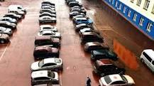
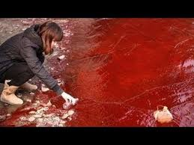
July 5, 2018 BLOOD RAIN!!
BLOOD-RED rain pouring over a remote Siberian city in Russia called Norils sparked fear and confusion.
Streets and cars colored red
Huge quanties of red iron oxide dust from Nadenzinsky plant of metal processing giant Norcnickel created the blood rain
Many industries of sparsely populated Siberia release toxic gases and liquids with little regulation

Slide 10
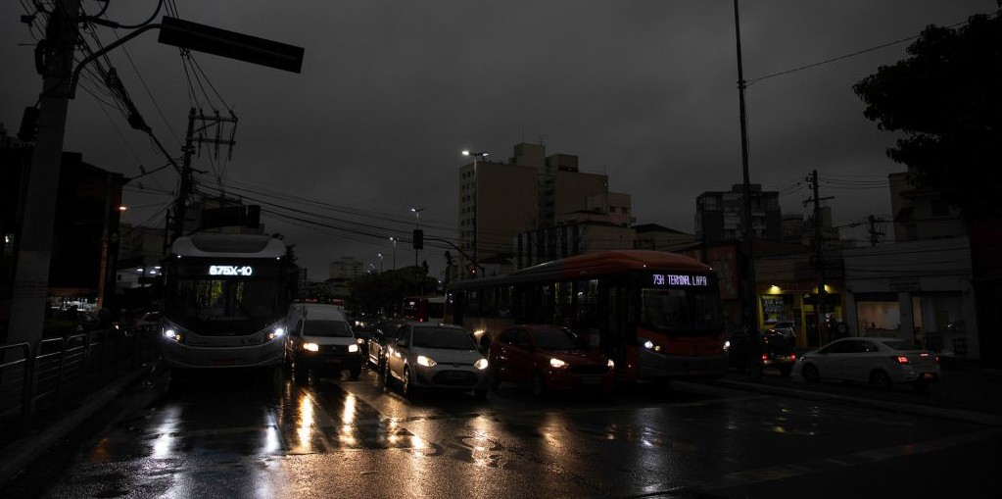
Forest Fire - Amazon, 2019
Day became night on the afternoon of Monday (Aug. 19) in São Paulo, Brazil.

Slide 11
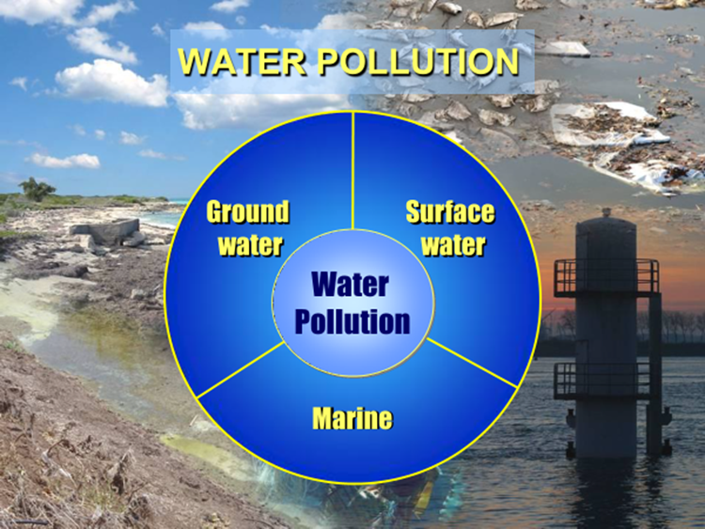
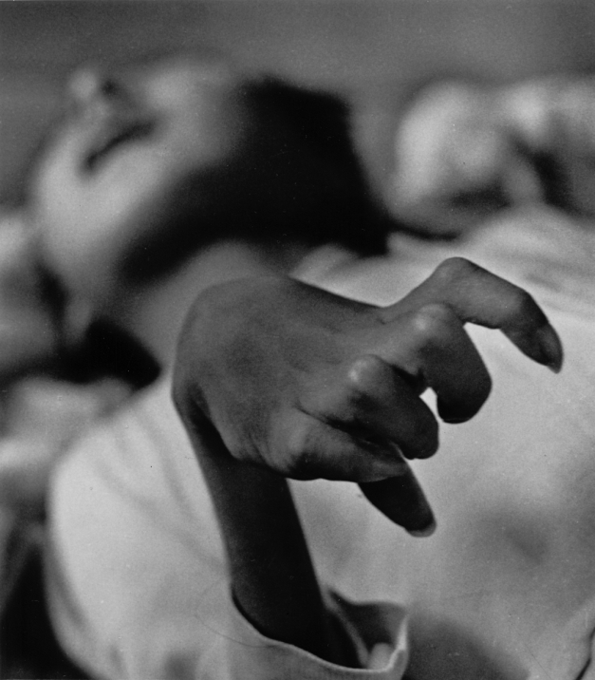
A FEW EXAMPLES OF DISASTROUS WATER POLLUTION
Minamata Disaster, Minamata Disease: The most massive pollution problem to strike Japan in the post WWII period. A neurological syndrome caused by methyl mercury in the industrial wastewater. Continued from 1932 to 1968 (36 years) 2 cities of Minamata and Niigata. Mercury salts were released from the Nippon Chisso Corporation's Minamata Chemical Factory The Showa-Denko’s Niigata Chemical Factory. 2,955 victims (2,009 people died), over 2 million people consumed the fish contaminated with methyl mercury.

Slide 12
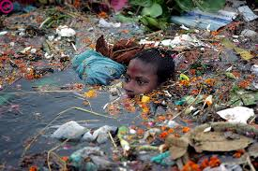
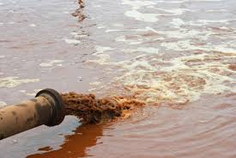
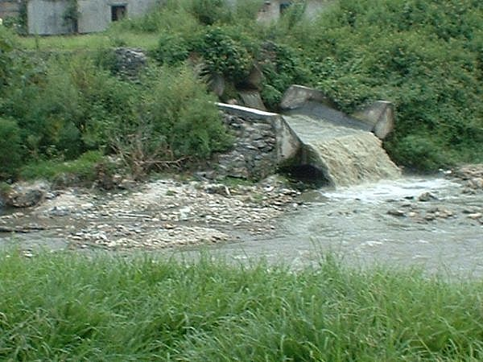
A Few Common Sights of Pollution of Water Bodies
Pollution of our Water Bodies
Pollution of the river Ganga is an enormous case.

Slide 13
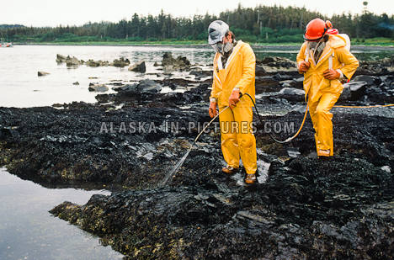
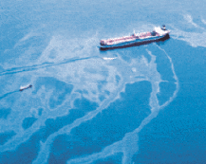
MARINE POLLUTION – THE OIL SPILL DISASTERS
It is estimated that 1.7 to 8.8 million metric tons of oil is released into global waters
There have been a number of oil spills with catastrophic environmental effects –such as The 1967 black tides from the oil tanker Torrey Canyon that spilled 120,000 tons of crude at Sicily island;
The Exxon Valdez oil tanker spill near Alaska in 1989;
The British Petroleum Oil Rig Explosion in 1910 and many others.
BP was fined about 20 billion $, the largest environmental fine in USA.
Oil Spill cleanup acivity
Exxon-Valdez Oil Tanker
The Clean-up Work

Slide 14
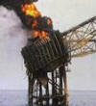
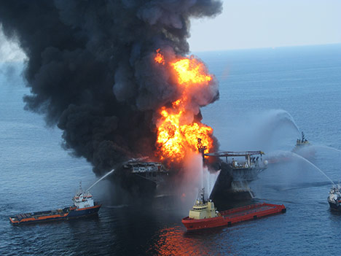
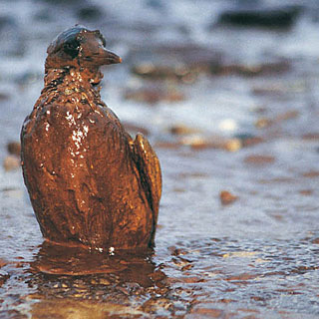
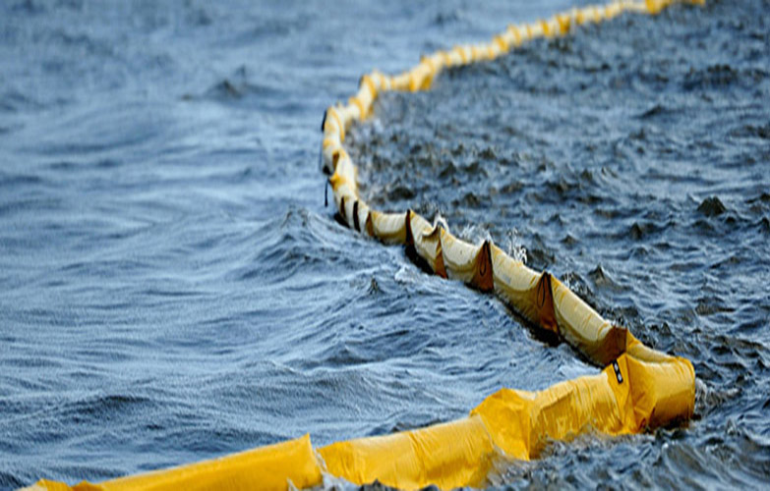
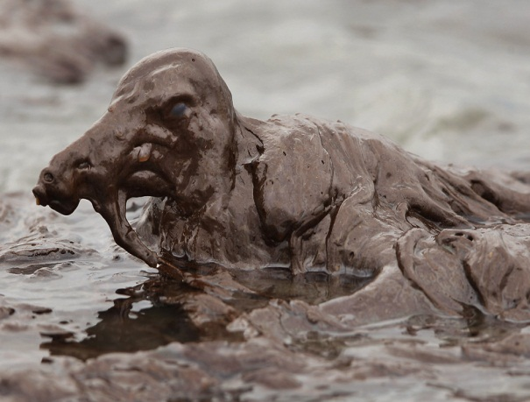
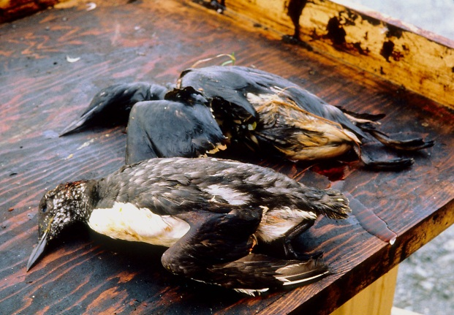
BP Oil Rig ablaze in Gulf of Mexico
An oiled bird on the beach
Oil spill cleaning

Slide 15
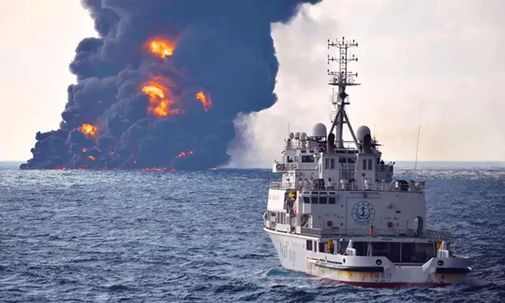
Burning Iranian Oil Tanker Sinks in East China Sea in January, 2018
Smoke and flames coming from the oil tanker The Sanchi at sea off the coast of China.
It burst into flames and sunk, eight days after a collision with a cargo ship off the coast of China.
Thirty crewmen died. Chinese officials have played down fears of a major environmental disaster.
The Sanchi was carrying 136,000 tonnes of light crude oil from Iran.
The smoke reached a height of 800-1000 meter

Slide 16
Soil Pollution Examples
Love Canal Case in USA
1896 William Love begins digging a canal between upper and lower Niagra river to generate hydro-electricity for the local industry. The project was abandoned halfway.
1942 A local chemical company starts dumping toxic wastes into the canal and this continues for several years. An estimated 21,000 tons of acids, pesticides and other toxic wastes filled in old drums goes into the canal. The area was covered with clay. By 1970, a school was built on the clay-covered dump site. Many people built home there. Soon the people fell sick with mysterious disease. There were many cases of birth defect in children. Eventually it was found that most of the sick people had cancer. The Government was alerted. The government bought the houses and the Love Canal was declared a disaster area. It took 20 years and $250 million to
clean up Love Canal.
Contaminated sites in India
There are many contaminated sites in India. The contaminants are Cr(VI), Copper compounds, pesticides, Polynuclear hydrocarbons (such as naphthalene). An inventory was prepared by a group of companies led by COWI of Denmark under a World Bank funded project. The report called “Inventory and Mapping of Contaminated Sites in Inda” was prepared in 2015. All these substances have acute health effects and many of them are carcinogenic. Decontamination of soil of these sites is being planned at the Govt level.

Slide 17
Chromium-contaminated sites near the Krebs and Cies Chromate manufacturing plant in Orissa

Slide 18
Location of the 320 probably contaminated sites in India

Slide 19
Global Meets on Environment
Deterioration of the environment in general got the attention of environmentalists as well as world leaders in 1960’s.
It was strengthened after publication of the book Silent Spring by Rachel Carson, a marine biologist, in 1962.
She passionately examined and described the effect of chlorinated pesticides on the living world.
The United Nations General Assembly organized the United Nations Conference on the Human Environment in 1972.
The Swedish Government hosted the conference in Stockholm. Leaders from 113 countries (that included the then Prime Minister of India) participated in the 12-day long conference (June 5-12, 1972), discussed the issues at length and converged on a 26 point action program to regulate and control environmental pollution.
The Stockholm Conference was the driver of change.
Some of the principles of the Stockholm Declaration were broadbased: Human rights must be asserted, apartheid and colonialism condemned, Natural resources must be safeguarded, The Earth's capacity to produce renewable resources must be maintained, Wildlife must be safeguarded, etc
The Preamble of the Stockholm Declaration said: “To achieve this environmental goal will demand the acceptance of responsibility by citizens and communities, and by enterprises and institutions at every level, all sharing equitably in common efforts”.

Slide 20
Major Follow-up Actions in India
Enactment of the first Environmental Legislation - The Water Act, 1974
Central Pollution Control Board was established – formation of State PCB’s followed.
Also two more Acts and a set of Rules were adopted and were amended from time to time.
42nd Amendment of the CONSTITUTION in 1976
Article 48A (Responsibilities of the State): The State shall endeavor to protect and improve the environment and safeguard the forests and wild life of the Country.
Article 51A (Responsibilities of the Citizens): It is the duty of every citizen to protect and improve the natural environment including forests, lakes, rivers and wild life.

Slide 21
Water (Prevention and Control of Pollution) Act, 1974 – often called the Water Act, 1974
Main objectives of this act:
-Prevention, control and abatement of water pollution.
-The act also aims at restoration of wholesomeness of water
-The water act is designed to assess pollution levels and punish polluters
-The central government and state governments have set-up pollution control boards to monitor water pollution
Central and state boards have been created under this act for preventing water pollution
-The act empowers the board to take:
- water samples for analysis
- govern discharge of sewage
- trade effluents
- study or inspect appeals
- revision of policies
- set minimum and maximum penalties
- publication of names of offenders
- offences by companies or government departments
- establish or recognize water testing laboratories and standard testing procedures
-Prevention and control of water pollution is achieved through a 'permit' or a 'consent administration' procedure
-Discharging effluents is permitted by obtaining the consent of state water boards

Slide 22
Air (Prevention and Control of Pollution) Act, 1974 – often called the Air Act, 1981
-The Air act aims at prevention, control and abatement of air pollution
-pollution beyond certain limits due to various pollutants discharged through industrial emission is monitored by pollution control boards set up in every state
-The Central Pollution Control Board (CPCB) implements legislation to improve quality of air, prevent and control air pollution in the country.
-The board advises the central government on matters concerning quality of air. It also coordinates activities, provides technical assistance and guidance to state boards in addition to setting the standards for quality of air.
-It collects and disseminates information in respect to air pollution and performs functions prescribed by the act.
-The state boards advise the state government on matters concerning prevention and control of air pollution
-The state boards possess the right to inspect at all reasonable times any control equipment, industrial plant or manufacturing process and give orders to take necessary steps to control pollution.

Slide 23
Air Act, Contd..
-The state board inspects air pollution control areas at regular intervals or whenever necessary.
-They are empowered to provide standards for emissions to be laid down for different industrial plants with regard to quantity and composition of emissions.
-A state board may recognize or establish a laboratory for this purpose.
-State government has powers to declare air pollution control areas after consulting with state boards. In the same manner, state government can give instructions to ensure standards of emission from automobiles and restrict operation of certain industrial units.
-Penalties are imposed by the state board and it might appeal to the court to restrain persons for causing air pollution.

Slide 24
ENVORONMENTAL PROITECTION ACT, 1986 – An Umbrella Act
Take all necessary measures for protecting quality of environment,
Co-ordinate actions of States, officers and other authorities under this Act,
Plan and execute a nationwide programs for prevention, control and abatement of environmental pollution,
Lay down standards for discharge of environmental pollutants,
Empower an officer to enter, inspect, take samples and test, establish or recognize environmental laboratories,
Appoint or recognize government analysts, lay down standards for quality of environment,
Restrict areas in which any industries, operations or processes may not be carried out subject to certain safeguards,
Lay down safeguards for prevention of accidents and take remedial measures in case of such accidents,
Lay down procedures and safeguards for handling hazardous substances,
Constitute an authority for exercising powers,
Issue directions to any person, officer or authority including the power to direct closure, prohibition or regulation of any industry, operation or process,
Require any person, officer or authority to furnish any prescribed information and
Make necessary rules to implement the Act.

Slide 25
A List of the more Important Environmental Statues (ACTS and Rules)
1. Water (Prevention and Control of Pollution) Act, 1974
2. Air (Prevention and Control of Pollution) Act, 1981
3. Environment (Protection) Act, 1986
Rules
The Manufacture, Storage and Import of Hazardous Chemicals Rules, 1989 replaced by Hazardous Waste (Management, Handling and Transboundary Movement) Rules, 2008, amended again in 2016
The Coastal Regulation Zone Notification, 1991
The Chemical Accidents ( Emergency, Planning, Preparedness, and Response) Rules, 1996
The Biomedical Waste (Management and Handling) Rules, 1998
– latest version Biomedical Waste Management Rules, 2016
Recycled Plastic manufacture and uses (Amendment) Rules, 2003
The Plastics Waste Management Rules, 2011, latest version of 2016
The Municipal Solid Waste (Management and Handling) Rules 2000,
latest version - Solid Waste Management Rules, 2016
The Hazardous & Other Waste Management Rules 2016
E-Waste (Management) Rules, 2016
Construction and Demolition Waste Rules, 2016
The Batteries (Management and Handling) Rules, 2001.
The Noise Pollution (Regulation and Control) (Amendment) Rules, 2000

Slide 26
Essential Features of a Few of the Rules
Plastic Waste Management Rules, 2016
More than 15,000 tonnes of plastic waste are generated across India every day
These rules shall apply to every
➢ Waste Generator
➢ Local body,
➢ Gram Panchayat,
➢ Manufacturer,
➢ Importers and producer.
Responsibilities of local bodies and gram panchayat.
Responsibilities of Waste Generator.
Collect back system and Extended Producer’s Responsibility or liability (EPR).
Responsibility of retailers and street vendors.
Registration of shopkeepers and street vendors
Recycled Plastic not to be used for packaging of edibles.
• Thickness of plastic shall be not less than 50 Microns.
• Plastic sheet forming part of integral packaging shall be not less than 50 Microns.
• Only Registered Producer to be provided Raw material.
• Plastic Sachets not be used for packaging Gutka, Pan masala, Tobacco

Slide 27
Responsibilities of the Local Body (Municipality/Panchayat/O)thers)
 Ensuring segregation, collection, storage, transportation, processing and disposal of plastic waste;
 Ensuring that no damage is caused to the environment during this process;
 Ensuring channelization of recyclable plastic waste fraction to recyclers;
 Ensuring processing and disposal on non-recyclable fraction of plastic waste in accordance with the
guidelines issued by the CPCB;
 Creating awareness among all stakeholders about their responsibilities;
 Engaging civil societies or groups working with waste pickers;
 Ensuring that open burning of plastic waste does not take place.
Responsibility of Waste Generator (Extended Producer’s Responsibility)
Waste generator shall minimize generation of plastic waste and segregate Not litter plastic waste and handover segregated plastic waste – local bodies
All institutional waste generator shall segregate and store in accordance with municipal solid waste management rules
All waste generator shall pay user fee.
Every person responsible for organising an event in open space, which involves service of food stuff in plastic or multilayered packaging shall segregate and manage the waste generated during such event.
The shopkeepers and street vendors supplying plastic carry bags shall register with local body on payment of a minimum fees of Rs. 48,000 i.e. Rs. 4000 p.m. as plastic waste management fees. Only the registered shopkeepers or street vendors shall be eligible to provide plastic carry bags for dispensing the commodities

Slide 28
Solid Waste Management Rules (SWM), 2016
First introduced in 2000 as Municipal Solid Waste (Handling and Management) Rules. 2000
It included all other kinds of non-hazardous wastes such as construction and demolition wastes
Separate Rules have been made for such wastes in 2016
SMW Rules suggest the well known hierarchy
Prevention
Minimization
Reuse
Recycling
Recovery, utilization including co-processing
Safe disposal
What are new?
Segregation at Source – three bag formula, degradable, non-degradable, domestic hazardous waste
• Local bodies empowered to collect ‘User Fee’ and levy ‘Spot Fine’ after framing suitable bylaws
• Bulk generators to develop composting facilities
• Promotion of compost marketing, Fertilizer Corporations to help in promoting compost
• Bringing policy on Waste to Energy; Tariff for energy from waste to be decided
• Integration of Rag pickers, Self Help Groups etc. in waste collection system after registration

Slide 29
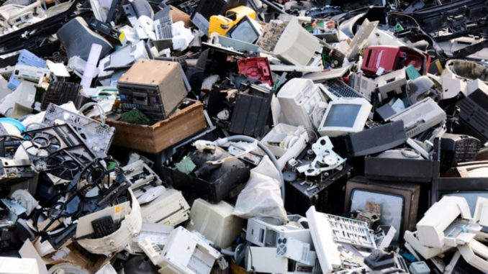
The E-Waste (Management) Rules, 2016
First introduced as E-Waste (Management and Handling) Rules, 2011, effective from May 1, 2012
The Rules enabled recovery and/or reuse of useful materials
from the plethora of E-Wastes.
For the first time, the concept of Extended Producer Responsibility
(EPR) was introduced – this was to make the
manufacturers liable for safe disposal of their products.
Formation of Producer Responsibility Organization (PRO) was stipulated.
PRO would be a professional organization authorized or financed collectively or individually by the Producer(s) to take
responsibilities for collection and channelizing E-wastes.
A PRO is an additional channel for implementing EPR.
An Amendment to the 2016 Rules was made in 2018 with
the objectives of channelizing the wastes generated to
dismantlers and recyclers and with reduced collection targets.
Collection target to increase by 10% every year.
Collection is entirely under EPR
The Producer may introduce Deposit Refund Scheme (as a security for
return of the goods after service life)
Dismantlers and recycles to have authorization.

Slide 30
National Policies on Environment and Natural Resources
Government of India adopted a number of policies relating to the Environment, Natural Resources and Sustainable Development.
The National Environment Policy (NEP) was adopted in the Parliament in 2006. Its essential features are:
Conservation of Critical Environmental Resources: To protect and conserve critical environmental resources and invaluable natural and man- made heritage which are essential for life-supporting livelihoods and welfare of the society.
Inter-generational Equity: To ensure judicious use of environmental resources to meet the needs and aspirations of present and future generations.
Efficiency in Environmental Resources Use: To ensure efficient use of environmental resources in the sense of reduction in their use per unit of economic output and to minimize adverse environmental impacts on society.
Environmental Governance in the Management of Resources: To apply the principles of good governance (i.e. transparency, rationality, accountability, reduction in costs and time, and public participation) to the management of environmental resources.
Enhancement of Resources: Appropriate technology and traditional knowledge for conservation and enhancement of resources.
Livelihood Security for the Poor: To ensure equitable access to environmental resources for poor tribal community.
Integration of Environmental Concerns for Socio-economic Development
National Water Policy was first adopted in 1987 and has been modified a few times The latest modification was done in 2002 highlights the importance of water for human existence as well as for all economic and development related activities. It addresses the problem of scarcity of water and the need to conserve this resource through optimal, economical, sustainable and equitable means.

Slide 31
Legislations in a few other countries:
Clean Air Act, 1955 in USA.
The Act has since been modified from time to time to cope with the growing need on more strict monitoring and regulation - 1963 Clean Air Act, The Clean Air Quality Act of 1967, 1970 Clean Air Act Amendments, 1977 Clean Air Act Amendments, 1990 Clean Air Act Amendments.
The US National Environmental Policy Act (NEPA) 1970 was signed on Jan 1, 1970 and the US Environmental Protection Agency (US EPA) was formed on December 2 of the same year.
US EPA has the overall responsibility of environmental monitoring and regulation. There are State Level agencies as well in the US.
Japan enacted the first comprehensive environmental law in 1967.

Slide 32
A number of major global conferences were held as continuation to the Stockholm Conference.
1992 Rio Conference on Environment and Development l Agenda 21, chapter 30: “Strengthening the Role of Business and Industry”, including “Promoting responsible entrepreneurship” l
2002 World Summit on Sustainable Development (Earth Summit 2 or Rio + 10) Political Declaration: “duty of the private sector to contribute to the evolution of equitable and sustainable communities and societies” and (para. 27) and “need for the private sector to enforce corporate accountability, …within a transparent and stable regulatory environment” (para 29)
2012 “Rio+20” Conference held at Johannesburg: “Green Economy, Green Growth”?

Slide 33
Towering Principles that Influence today’s
Environmental Laws
The Precautionary Principle (PP)
The Prevention Principle (P2)
The Polluter Pays Principle (PPP)
The Sustainable Development Principle

Slide 34
PRECAUTIONARY PRINCIPLE (PP)
Natural Environment has a limited capacity of absorbing the
ill-effects of contamination. Beyond certain limits, they
cause damage to life and property.
Environmental Laws regularly operate in areas complicated by high levels of scientific uncertainty!
The Precautionary Principle has been defined in Principle 15 of the Rio Declaration (Agenda 21)
In order to protect the environment, the precautionary approach shall be widely applied by States according to their capabilities. Where there are threats of serious or irreversible environmental damage, lack of full scientific certainty should not be used as a reason for postponing measures to prevent environmental degradation.

Slide 35
Precautionary Principle (PP) in Practice
Precautionary Principle is manifest in several multilateral Environmental Agreements
The Montreal Protocol on ODS, 1987
The Rio Declaration on Environment and Development, 1992
UN Framework Convention on Environment and Development, 1992
Convention on Biological Diversity, 1992
Cartagena Protocol on Bio-safety, 2000
Stockholm Convention on POP’s, 2001
PP is not explicitly mentioned in our environmental laws
It is explicitly mentioned in the environmental laws of many African (South Africa, Mozambique, Cameroon) and Latin American countries (Argentina, Peru, Costa Rica)
It has been amply referred to and enunciated in a number of cases by
Hon’ble Supreme Court of India – for example
Vellore Citizens’ Welfare Forum Case on tannery effluents
Taj Trapezium Case (this refers to the effect of SO2 on the Taj Mahal and over a 10,400 sq km area around the Taj): PIL by M C Mehta
Calcutta Tanneries Case

Slide 36
Prevention Principle, P2…
In essence, Pollution Prevention is largely based on clean and
green technologies, and adoption of green operating practice.
Pollution Prevention has a great role in Sustainable
Development
In most of the countries, Pollution Prevention remains at the
policy level.
In the US, Pollution Prevention Act was passed by the Congress
in 1990. This act and associated executive orders allow a
number of opportunities for prevention of pollution.

Slide 37
The Polluter Pays Principle (PPP)
There are ramifications of this principles in ancient literature.
There is no agreed definition of PPP
PPP was explicitly mentioned in Principle 16 of the Rio Declaration (1992):
National Authorities should endeavor to promote the internalization of environmental costs and the use of economic instruments, taking into account the approach that the polluter should, in principle, bear the cost of pollution, with due regard to the public interest and without distorting
international trade and investment.
United Nations Environmental Program (UNEP) says: The Polluter Pays Principle for damage to the environment should bear the costs associated with it.
PPP is a method for internalizing the externalities. Internalization requires that all the environmental costs be borne by the producer/consumer instead of the community as a whole. Polluter should pay for the pollution cost measures – such as construction and operation of anti-pollution installations, investment for control equipment, etc.

Slide 38
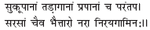
The Polluter Pays Principle in the Ancient Society
The principle has been stated in different forms in ancient literature
An excerpt from The Dialogue of Plato:
“If anyone intentionally spoils the water of another … let him not
only pay damages, but purify the stream or cistern which contains
the water.”
- Vol 4, book 8, section 485
- Padmapurana, Bhimi 96.7.8
Those who pollute pure water from wells, rivers, fountains, or ponds must go to hell.

Slide 39
The Polluters-Pay Principle in Practice
There are numerous examples of application of this principles and imposition of
heavy penalties in developed countries.
Example: Oil spill cases – Exxon-Valdez oil spill, Exxon had to pay about $1 billion;
Gulf of Mexico oil spill in 2010, BP agreed to pay $18.7 b
An escape route is “Cap-and-Trade’ (Carbon Trade)
Bhopal disaster – an out of court settlement was made, reportedly far below
the damage, Govt had to take a lot of burden.
The Indian Supreme court imposed fines for pollution in many cases, the biggest
one being Rs 100 crore fine on Starlite a multinational for mining and metallurgical
polluting activity.
Imposed fines on many other industries big and small
Pollution tax imposed on heavy vehicles for entering
Delhi (varying from Rs 700 to 1300 per entry)

Slide 40
Sustainable Development Principle
Sustainable Development was defined as : The development that meets the needs of the present without compromising the ability of the future generations to meet their own needs.
The Brundtland Report was central in framing the discussion at the United Nations Conference on Environment and Development (UNECD) well known as the Earth Summit at Rio.
Poverty has been identified as a major factor for environmental deterioration. Eradication of poverty occupied a key position in the Sustainable Development Goals adopted by UN General Assembly in 2015.

Slide 41
How are Prosperity and Eradication of Poverty
related to Environmental Quality?
The principles of Sustainable Development stipulates eradication of poverty
as a criterion or objective.
Is environmental quality in a country related to its prosperity or per
capita income?
The answer is given by the Environmental Kuznets Curve (EKC)
What is Kuznets Curve?
Simon Kuznets, in his Presidential Address in the 76th annual meeting of American
Economic Association, 1954, suggested a relation between Economic Growth and
Income Inequality.
The graphical representation of the relation is the famous Kuznets Curve.

Slide 42
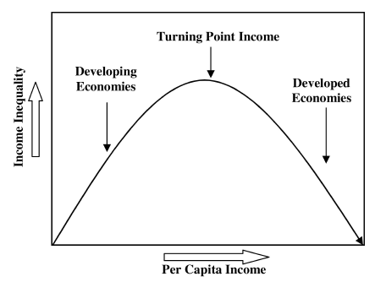
The plot of Income Inequality
against Per Capita Income is
an inverted U-shaped curve.
Distribution of income becomes
more unequal at early stages of
economic growth, but eventually
moves back to greater equality.
There has been a lot of discourse
on the Kuznets Curve.
The Kuznets Curve
In 1991, The Kuznets Curve took on a new existence. The World Bank Report entitled
World Development Report, 1992, popularized the Environmental Kuznets Curve.
The data on ambient air and water quality in cities worldwide were regressed on a
polynomial in GDP per capita and the plot was called the Environmental Kuznets Curve

Slide 43
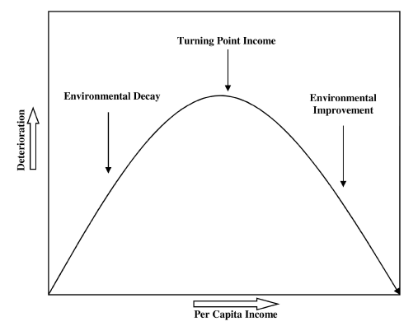
The Environmental Kuznets Curve (EKC)
Other functional forms including higher order polynomials have been attempted.
The turning point of the EKC for individual pollutants differ across countries.

Slide 44
How we in India are doing?
Environmental Performance Index (EPI)
The Center for Environmental Law and Policy, Yale University and The Center for International Earth Science and Information Network of Cornell University developed the concept of Environmental Performance Index (EPI)
It is based on a number of criteria and factors.
There are 24 performance indicators across ten issue categories covering environmental health and ecosystem vitality.
These metrices provide a gauge at a national scale of how close countries are to established environmental policy goals. The EPI thus offers a scorecard that highlights leaders and laggards in environmental performance, gives insight on best practices, and provides guidance for countries that aspire to be leaders in sustainability.
According to the 2016 listing of 180 countries, Finland was on the top and India’s position was 141. 2018 ranking places India at 177 followed by Democratic Republic of Congo, Bangladesh and Burundi. Switzerland tops the 2018 list.

Slide 45
Environmental Performance Index (EPI) – Center for Environmental Law and Policy, Yale Univ
and Center for International Earth Science Information, Cornell Univ
Air Quality
PM10
PM2.5
Household
solid fuel
Water Quality
Sanitation
Drinking
Water
Heavy Metals
Biodiversity
& Habitat
Biome protection
Species ,,
Species habitat
Etc.
Forests
Tree cover
loss
Fisheries
Regional
Marine
Trophic
index
Climate
& Energy
CO2 emission
CH4 emission
N2O ,,
Black C ,,
Air
Pollution
SO2 emission
NOx emission
Water Resources
Waste
water
treatment
Agriculture
Sustainable
nitrogen
management

